Slide 1
Ethical Issues in Treating LGBT Patients
Jack Drescher, MD
jackdreschermd@gmail.com
www.jackdreschermd.net

Slide 2
Ethical Issues in Treating LGBT Patients
Part I: Principles of Medical Ethics
Part II: Definition of Terms
Part III: History
Part IV: Ethics in the Clinical Setting

Slide 3
The Principles of Medical Ethics
With Annotations Especially Applicable to Psychiatry
(2009)

Slide 4
Section 1
A physician shall be dedicated to providing competent medical care, with compassion and respect for human dignity and rights
Annotation 2: A psychiatrist should not be a party to any type of policy that excludes, segregates, or demeans the dignity of any patient because of ethnic origin, race, sex, creed, age, socioeconomic status, or sexual orientation

Slide 5
Section 5
A physician shall continue to study, apply, and advance scientific knowledge, maintain a commitment to medical education, make relevant information available to patients, colleagues, and the public, obtain consultation, and use the talents of other health professionals when indicated
Annotation 1: Psychiatrists are responsible for their own continuing education and should be mindful of the fact that theirs must be a lifetime of learning

Slide 6
Definition of Terms

Slide 7
Sexual Orientation
A person’s erotic response tendency or sexual attractions, be they directed toward individuals of the same sex (homosexual), the other sex (heterosexual) or both sexes (bisexual)
Consists of three components—desire, behavior, and identity—which may or may not be congruent in an individual

Slide 8
Sexual Identities
The subjective experiences of one’s sexual desires or attractions
Homosexual, lesbian, gay, or bisexual identities involve some measure of self-acceptance of one’s homosexual desires, and perhaps an identification with a community of similar others by virtue of having same-sex attractions

Slide 9
Sexual Identities
Acquisition of sexual identities is often conceptualized as a developmental process that occurs over time
Not all persons who experience homoerotic desire or participate in homosexual behavior develop a lesbian, gay, or bisexual identity
A sexual identity (how I think and feel about my sexual attractions) is not synonymous with a sexual orientation (to whom I am attracted)

Slide 10
Sexual Identities
The terms gay, gay man, lesbian, and bisexual emerged in popular usage as a way to refer to men and women whose sexual identity, to some degree, openly recognized their homosexual or bisexual attractions
Gay is sometimes also used as a politically inclusive term for both men and women whether homosexual or bisexual

Slide 11
Sexual Minorities
An inclusive term, sometimes used as an alternative to the “alphabet soup” of “LGBTQQI”
As in the case of racial, ethnic or religious minorities, implies some political status in relationship to a dominant cultural group

Slide 12
Sex (As opposed to Gender)
The status of biological variables that can be described as either male-typical or female-typical in normatively developed individuals (e.g., genes, chromosomes, gonads, internal and external genital structures)

Slide 13
Gender
Gender identity: one’s persistent inner sense of belonging to either the male or female gender category
Gender role: those things one says or does to disclose oneself as having the status of boy or man, girl or woman, respectively (e.g., general mannerisms, deportment and demeanor; spontaneous topics of talk in unprompted conversation and casual comment; content of dreams, daydreams and fantasies)

Slide 14
Gender
Gender role is an outward expression of the inner sense of gender identity
Gender expression increasingly used in legal documents

Slide 15
Transgender
Originally coined in early 1970s to refer to people who lived full-time in a gender not associated with the one that usually went with their genitals
Broadly used today to define individuals who are not conventionally “gendered”
Natal sex, birth assigned sex (not “biological” sex)

Slide 16
Cisgender
A term used in the transgender community to describe individuals whose gender identities align with their assigned sex at birth (non-transgender)
Origin in the Latin-derived prefix cis, meaning ‘on the same side’ as in the cis-trans isomer distinction in chemistry

Slide 17

Cis/Trans Isomers

Slide 18
Transsexual
Individual using hormonal or surgical means to modify the body so that it conforms to the gender identity
Gender Reassignment (formerly Sex reassignment)
Partial versus Complete Transition
Male to Female (MTF, Transwoman)
Female to Male (FTM, Transman)
Gender identity and sexual orientation may be independent variables

Slide 19

Trans woman (Transwoman)
Male to Female [M to F, MTF]
(Caitlyn Jenner)

Slide 20

Trans man (Transman)
Female to Male [F to M, FTM]
(Chaz Bono)

Slide 21
Transvestism (Transvestitism)
Cross-dressing
Drag: Entertainment
Transvestic Disorder (Transvestic Fetishism)
  DSM-5 Paraphilic Disorder
  Previously only heterosexual males (DSM-IV)
  recurrent, intense sexually arousing fantasies, sexual urges or behaviors involving cross-dressing

Slide 22
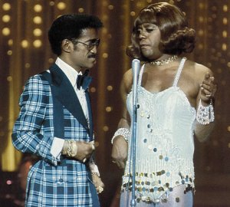
Drag

Slide 23
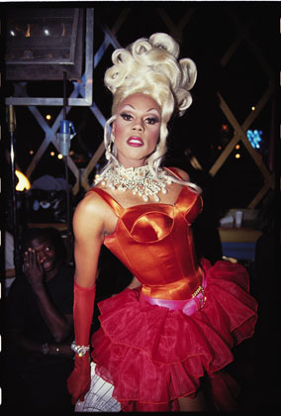
Gay Drag

Slide 24

Drag Kings

Slide 25
Intersex
“Hermaphrodites”
“Disorders of Sexual Development”
Congenital anomaly of the reproductive and sexual system
Encompasses a wide variety of conditions
Most intersex people identify as men or women

Slide 26
History

Slide 27
Historical Attitudes to LGBT Patients
Characterized by attitudes that could be construed as patronizing at best and, at worst, overtly hostile
Mental health prejudices against LGBT patients still persist, albeit in subtler forms such as sparse research on the health and mental health needs of these populations (Institute of Medicine, 2011)

Slide 28
Homosexuality as Psychiatric Diagnosis

Slide 29
19th Century: From Sin to Illness
Psychiatrists began classifying homosexuality as a mental disorder.
1869: The invention of the “homosexual”
1886: Krafft-Ebing: Psychopathia Sexualis

Slide 30
20th Century: Psychoanalysis
Starts to move away from the illness model but eventually moves back.
1905: Freud’s “Developmental Arrest”—not quite an illness, but not quite normal
1940-1992: Psychoanalysts primarily view homosexuality as a “perversion” and a condition in need of “treatment”

Slide 31
Psychoanalysis
Theory of homosexuality based on studies of
  Individual patients seeking treatment who are unhappy about their sexual orientation (case histories)
  Prison populations
Sexology Research: Field studies of non-patient populations

Slide 32
20th Century: Sexology Research
The move toward a view of homosexuality as a “normal variant” of human sexuality (left-handedness)
1948 and 1953: The Kinsey Reports
1957: Evelyn Hooker

Slide 33
Alfred Kinsey
Insect taxonomy
Evolutionary importance of variations within a species
Thousands of detailed interviews about people’s sexual practices (non-patients)
Kinsey scale (0-6)
High rates of homosexuality (10-37%) argued in favor of normal variation

Slide 34
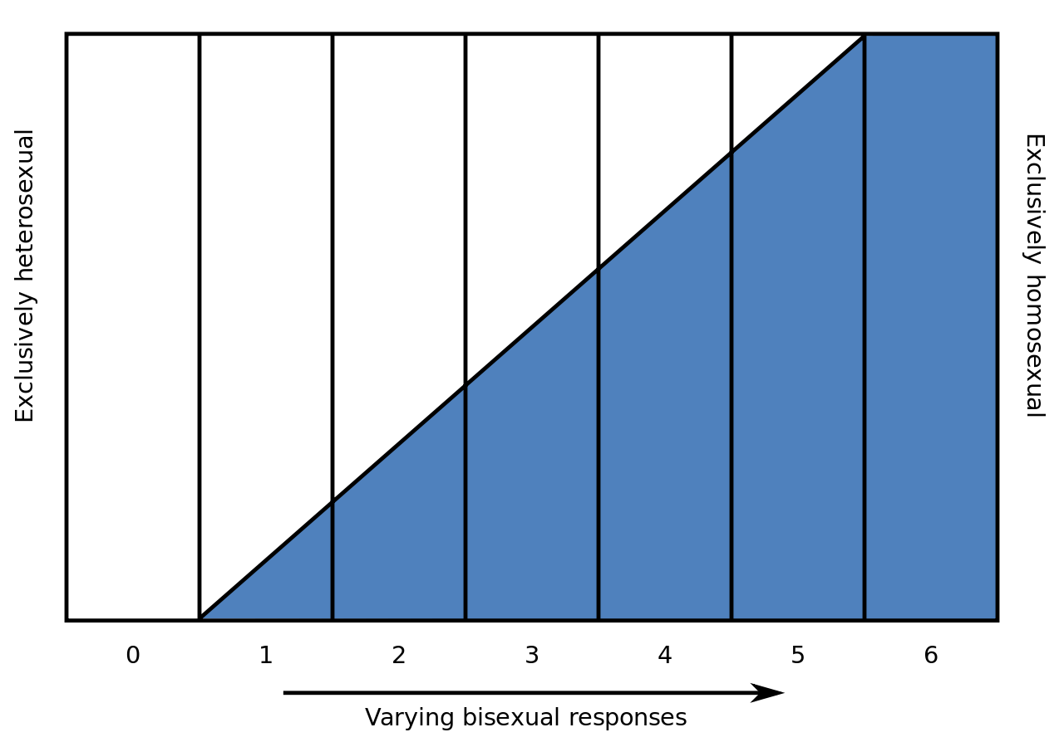
Kinsey Scale
Kinsey 0: Exclusive Heterosexuality
Kinsey 6: Exclusive Homosexuality
Five Grades of Bisexuality (Kinsey1-5)

Slide 35
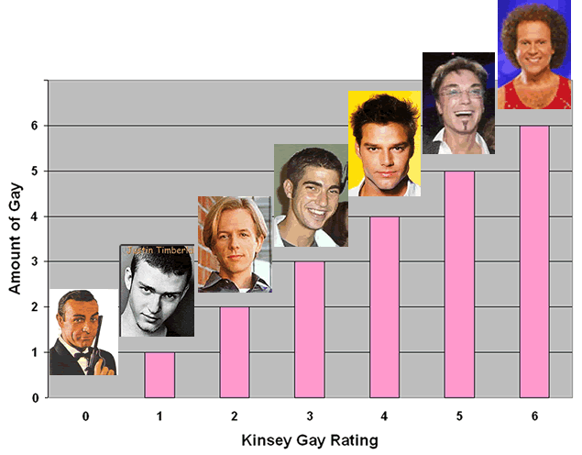

Slide 36
Evelyn Hooker
1957: Study compared non-patient homosexual men with heterosexual controls
Use of projective tests to elicit psychopathology
“Blind” judges
No significant differences found between two groups
Reproducible experiment
Results at odds with prevailing, dominant psychoanalytic theory of the time—supports normal variant point of view

Slide 37
1973: APA Decision
1969: Stonewall riots begin modern gay liberation movement.
1970: Gay activists “zap” APA meetings
1972: Dr. H. Anonymous

Slide 38
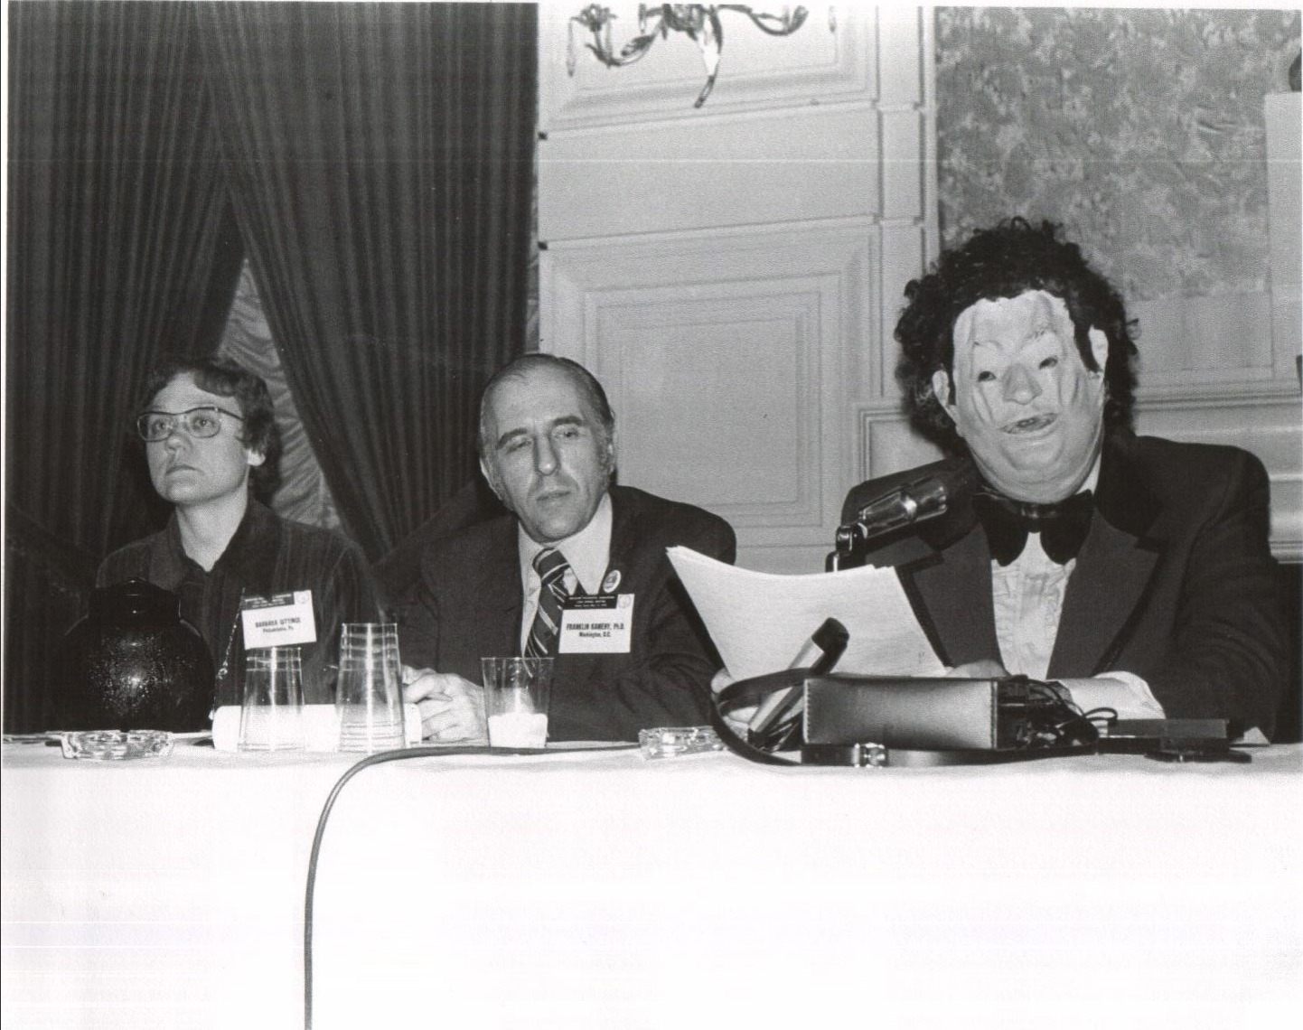
Dr. H Anonymous (John Fryer, MD)

Slide 39
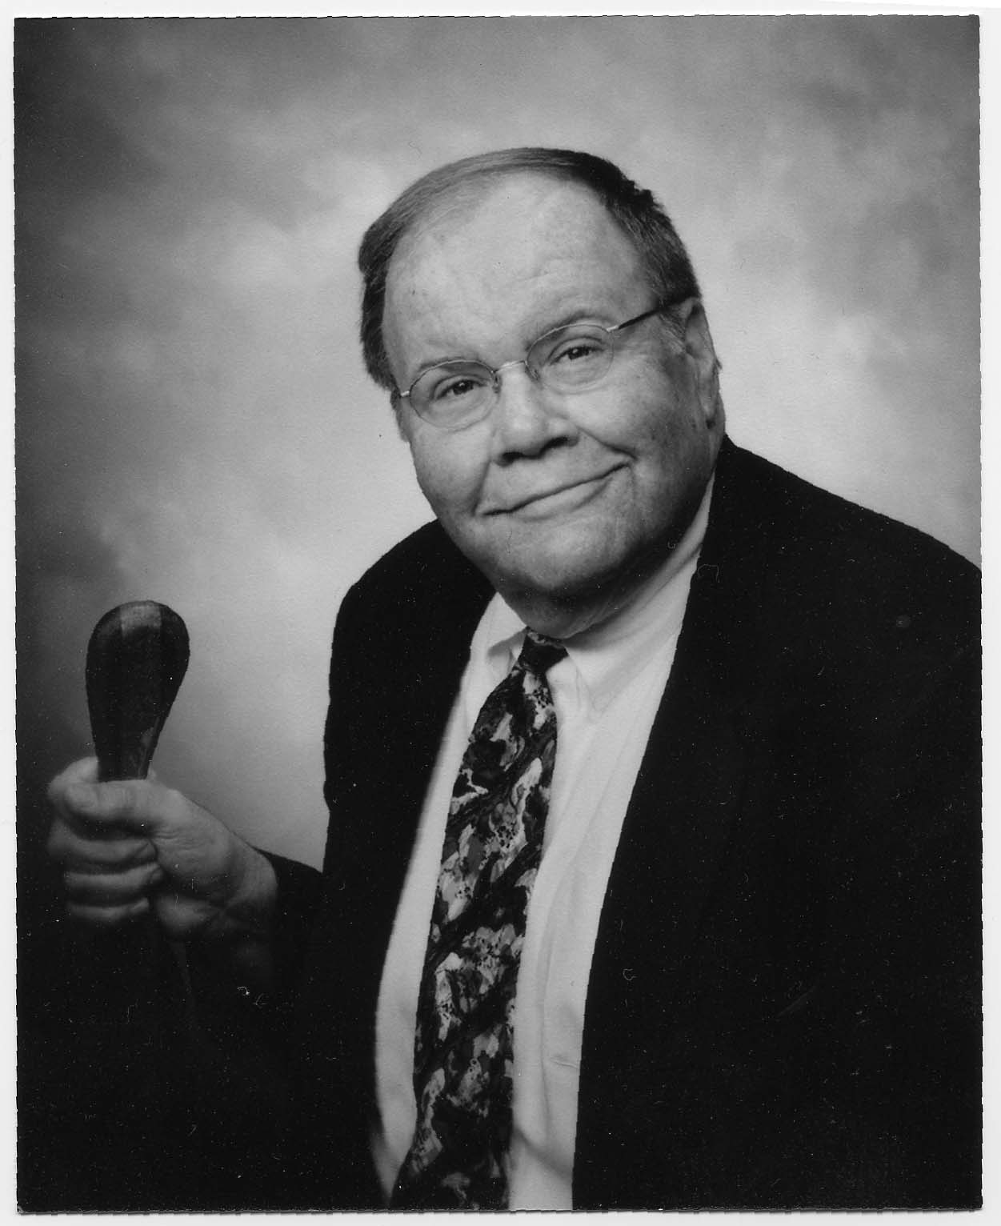
John Fryer, MD

Slide 40
The 1973 APA Decision
1972-73: Scientific Committees review the literature
1973: APA leadership removes “homosexuality” per se from the Diagnostic Manual (DSM)
1974: Psychoanalysts petition for a membership referendum
58% APA members vote to support the decision

Slide 41
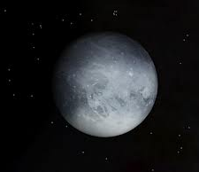
Can scientific questions be decided by a vote?
Absolutely!
In 2006 the International Astronomical Union voted Pluto is no longer a planet
Subjectivity must be accompanied by some consensually validated reality

Slide 42


Slide 43
Homosexuality in the DSM
DSM-I (1952): Sociopathic Personality Disturbance
DSM--II (1968): Sexual Deviation
1973: Homosexuality per se removed from DSM-II and replaced by “Sexual Orientation Disturbance”
DSM-III (1980): Ego-dystonic homosexuality (EDH)
DSM-III-R (1987): EDH removed
DSM-IV (1994) and DSM-IV-TR (2000): Sexual Disorder NOS
3. Persistent and marked distress about sexual orientation
DSM-5: none

Slide 44
Homosexuality in the ICD
ICD-6: (1948): Sexual Deviance (Pathological Personality)
ICD-7 (1955): Sexual Deviance (Pathological Personality)
ICD-8 (1965): Sexual Deviance
ICD-9 (1975): Sexual Deviations & Disorders
ICD-10 (1990): Homosexuality removed but . . .
  Sexual Maturation Disorder
  Ego Dystonic Sexual Orientation
  Sexual Relationship Disorder
ICD-11 (2018): none

Slide 45
Gender Variance as Psychiatric Diagnosis

Slide 46
Transgender
Krafft-Ebing (1886): Transgenderism as psychopathology
  Psychopathia Sexualis documents both cases of gender dysphoria and of gender variant individuals born to one sex yet living as members of the other
  “Homosexuality”
Magnus Hirschfeld (1923): Distinguished the desires of homosexuality (to have partners of the same-sex) from the desires of transsexualism (to live as the other sex)

Slide 47

Lili Elbe
Has 5 operations in 1930-1931, some under Hirschfeld’s supervision
Died of complications following fifth surgery (implanted uterus)
Subject of David Ebershoff novel, The Danish Girl, released as 2015 film

Slide 48
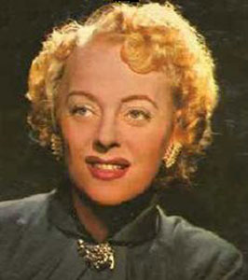
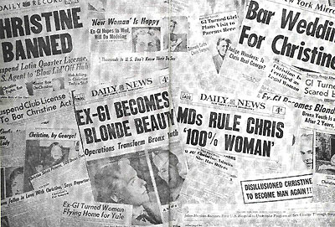
Christine Jorgensen
(1926-1989)

Slide 49
Christine Jorgensen
GRS seized popular imagination when George Jorgensen went to Denmark a natal man and returned to the U.S. in 1952 as trans woman
Transvestism: Hormonal, psychiatric, and surgical treatment. Journal of the American Medical Association, 12, 391-396, 1953
--Hamburger, Stürup & Dahl-Iversen

Slide 50
1950s-1980
Transsexualism or GID diagnoses do not appear in DSM-I (1952) or DSM-II (1968)
Many physicians and psychiatrists, and particularly psychoanalytic practitioners, criticized using surgery and hormones to irreversibly—and in their view incorrectly—treat people suffering from what they perceived to be either a severe neurotic or psychotic, delusional condition in need of psychotherapy and “reality testing”

Slide 51
1960s Survey of 400 Physicians
Green (1969)
Eight percent [8%] of the respondents considered the transsexual “severely neurotic” and fifteen percent [15%] considered the person “psychotic.” The majority of the responding physicians were opposed to the transsexual’s request for sex reassignment even when the patient was judged nonpsychotic by a psychiatrist, had undergone two years of psychotherapy, had convinced the treating psychiatrist of the indications for surgery, and would probably commit suicide if denied sex reassignment. Physicians were opposed to the procedure because of legal, professional, and moral and/or religious reasons.

Slide 52
Early Contributors to
Gender Identity Diagnoses
John Money
Harry Benjamin
Robert Stoller
Richard Green

Slide 53
John Money
Starting in 1950s, studied children born with intersex conditions at Johns Hopkins
Gender identity is acquired and determined by external, environmental factors
Gender identity fixed by 3 years of age, and changing difficult if not impossible in anyone older
Parental attitudes determine whether a child accepts the gender category to which it had been surgically and medically assigned

Slide 54
Harry Benjamin
Credited with popularizing the term transsexual in current usage and raising awareness within the medical profession
Believed psychotherapeutic efforts to change gender identity were “futile”
Pioneered the treatment of gender dysphoric individuals using sex hormones
Worked in a private practice setting without university or academic support

Slide 55
Robert Stoller
Psychoanalyst who worked with transsexual and intersex patients (USC)
Coined term “gender identity” (1964)
Believed in some cases, childhood family dynamics “caused” adult transsexualism

Slide 56
Richard Green
Psychiatrist, student of Money, residency with Stoller, worked with Benjamin
Known for his early work with gender dysphoric children (USC)
The “Sissy Boy Syndrome” and the Development of Homosexuality (1987)

Slide 57
DSM Gender Diagnoses
Edition (year) | Parent Category | Diagnosis Name
DSM-I (1952) | N/A | N/A
DSM-II (1968) | Sexual Deviations | Transvestitism
DSM-III (1980) | Psychosexual Disorders | Transsexualism Gender identity disorder of childhood
DSM-III-R (1987) | Disorders usually first evident in infancy, childhood or adolescence | Transsexualism Gender identity disorder of childhood Gender identity disorder of adolescence and adulthood, nontranssexual type

Slide 58
DSM Gender Diagnoses
Edition (year) | Parent Category | Diagnosis Name
DSM-IV (1994) | Sexual and gender identity disorders | Gender identity disorder in adolescents or adults Gender identity disorder in children
DSM-IV-TR (2000) | Sexual and gender identity disorders | Gender identity disorder in adolescents or adults Gender identity disorder in children
DSM-5 (2013) | Gender dysphoria | Gender dysphoria in adolescents or adults Gender dysphoria in children

Slide 59
ICD Gender Diagnoses
Edition (year) | Parent Category | Diagnosis Name
ICD-6 (1948) | N/A | N/A
ICD-7 (1955) | N/A | N/A
ICD-8 (1965) | Sexual Deviations | Transvestitism
ICD-9 (1975) | Sexual Deviations | Transvestism Trans-sexualism

Slide 60
ICD Gender Diagnoses
Edition (year) | Parent Category | Diagnosis Name
ICD-10 (1990) | Gender Identity Disorders | Transsexualism Dual-role transvestism Gender identity disorder of childhood Other gender identity disorders Gender identity disorder, unspecified
ICD-11 (2018) | Conditions Related to Sexual Health | Gender incongruence of adolescents and adults Gender incongruence of children (Proposed)

Slide 61
Ethics in the Clinical Setting

Slide 62
Ethics in the Clinical Setting
Dearth of empirical research on the health and mental health needs of LGBT patient populations (IOM, 2011)
Most psychiatrists, as well as physicians in other specialties and other mental health professionals, receive little formal training in human sexuality
General public unaware how little attention is given to human sexuality in clinical education

Slide 63
Ethics in the Clinical Setting
Patients may ask questions about sex and gender that clinicians do not know how to answer
Rather than admitting lack of knowledge, or seeking out reputable sources of information, clinicians may
  Proffer an old theory learned in university or graduate school
  Express personal beliefs or other incorrect information
  Countertransferences

Slide 64
Questions Patients Ask

Slide 65
“Doctor, Why am I Gay
(or Transgender)?”
Answer: We don’t know!

Slide 66
The “Why” Question
Not unusual for LGBT patients to ask
Not typical question for heterosexual and cisgender patients
Clinicians unlikely to raise question with heterosexual and cisgender patients
LGBT patients as members of sexual minority often have outsider’s feeling that their identities require explanation

Slide 67
The “Why” Question
The “causes” of a patient’s sexual orientation and gender identity are unknown
Two people talking to each other in a therapist’s office can only discover what sexual orientation and gender identity means to either or both of them
Conducting a psychotherapy under the false assumption that one can find out “why” a patient is LGBT is ethically questionable and a waste of time and money
Notes:
I wish to state from the outset that I believe analytic theories, like analytic histories, are subjectively co-constructed./ So what follows stems from my subjectivity, that of a gay psychoanalyst working within an analytic perspective that sees the therapist primarily as an advocate for the patient, rather than for the patient’s social milieu./
Other psychoanalytic values that inform my treatment approach include Winnicott’s concept of the holding environment and Bion’s notion of containment./ Both therapeutic attitudes create a setting in which patients feels safe, respected, and accepted./ In addition, Sullivan’s detailed inquiry shows patients the value of curiosity./.

Slide 68
“Doctor, Can You Change My Sexual Orientation ?”
Answer: No one knows how!

Slide 69
The “Change” Question
Mainstream mental health organizations do not endorse sexual orientation change efforts (SOCE)
“Techniques” are not offered in reputable mental health training programs
Majority of SOCE practices are conducted by unlicensed, non-clinicians and “ex-gay” ministries

Slide 70
The “Change” Question
American Psychiatric Association (2000): “ethical practitioners refrain from attempts to change individuals’ sexual orientation, keeping in mind the medical dictum to First, do no harm”
American Psychological Association (2009): “Efforts to change sexual orientation are unlikely to be successful and involve some risk of harm, contrary to the claims of SOCE practitioners and advocates”

Slide 71
Currently Ban Conversion Therapies for Minors
California (2012)
  Upheld by 9th Circuit on Appeal (2013)
  SCOTUS refused to hear appeal (2014)
New Jersey (2013)
  Upheld by 3rd Circuit on Appeal (April 2015)
  SCOTUS refused to hear appeal (May 2015)
Washington DC (2014)
Oregon (2015)
Ontario (2015)
Illinois (2015)

Slide 72
Legislative Actions Following CA and NJ Bans
18 other US states, legislators have introduced bills banning conversion therapy for minors
Federal legislation has been introduced in House of Representatives (2015)
2015: Obama Administration Calls for End to Conversion Therapies
Oklahoma (2015): Legislation introduced unsuccessfully to prevent government from interfering with conversion therapies

Slide 73
Ferguson et al. v JONAH
In 2012, SPLC files lawsuit against JONAH
Plaintiffs: 3 young men who were harmed by the practice and two parents who paid fees to JONAH for their sons’ therapy. Customers of JONAH’s services typically paid a minimum of $100 for weekly individual counseling sessions and another $60 for group therapy sessions.

Slide 74
Ferguson et al. v JONAH
JONAH “Treatment” Practices
  One plaintiff encouraged to undress and stand naked in a circle
  Counselor encouraged 3 male plaintiffs to undress in front of a mirror and touch their genitals while he watched
  Group activities organized for clients to re-enact past abuse and take part in violent role-play exercises; encouraged clients to blame their parents for being gay
  Male counselors engaged in and advocated “healthy touch” with young men, including prolonged cuddling sessions

Slide 75
Ferguson et al. v JONAH
One defendant was co-founder, Arthur Goldberg, former Wall Street executive and attorney previously convicted of 3 counts mail fraud and 1count of conspiracy to defraud the federal government. He was ultimately disbarred from being an attorney
Another defendant, Alan Downing, was unlicensed “life coach”

Slide 76
Ferguson et al. v JONAH
5 out of 6 NARTH experts were not allowed by judge to testify
June 2015: After 3-week trial, jury found the services JONAH claimed could change clients from gay to straight were fraudulent and unconscionable.
Jury ordered JONAH, Goldberg and Downing to pay $72,400 to compensate the 5 plaintiffs for fees paid to the group and for mental health counseling one of the plaintiffs needed afterward

Slide 77
“Doctor, What Did You Call Me?”
Answer: How Do You Prefer to be Addressed?

Slide 78
How to Address Patients
Respectful language rather than medical terminology
“Gay” rather than “homosexual”
“Transgender” rather than “transsexual”
Preferred name
Preferred Pronouns
Ask!! There are always exceptions

Slide 79
“Doctor, Are You Gay, Lesbian, Bisexual or Transgender ?”
Answer: Who Wants to Know?

Slide 80
Therapist Self Disclosure
LGBT patients often seek LGBT therapists and LGBT therapists are often willing to come out to patients
In a heterosexist society, everyone is considered heterosexual until declared or labeled otherwise
Disclosing one’s sexual identity is not an issue that stirs many heterosexuals
Some think self disclosure is wrong

Slide 81
Arguments Against
Therapist Self Disclosure
Keep primary focus of therapeutic conversation on patient’s inner world, rather than that of the therapist
Some patients may feel burdened by having knowledge about their therapists
A way to teach fledgling therapists boundaries
A way to elicit information from patients

Slide 82
Arguments For
Therapist Self Disclosure
Coming out is important developmental step in the lives of LGBT people
LGBT therapists should always come out to patients lest they countertransferentially perpetuate a patient’s feelings of secrecy and shame (Isay)
Little empirical evidence supporting non-disclosure as superior therapeutic technique compared to self-disclosure

Slide 83
Arguments For
Therapist Self Disclosure
No studies showing head to head comparisons in the two approaches
In the Internet age, patients already know a lot about their therapists
Gay-dar
Transferences develop whether or not a patient knows about a therapist

Slide 84
Therapist Self Disclosure
An ethical approach to self-disclosure should depend upon whether the activity is of therapeutic value to the patient
Ascertaining the merits of self-disclosure requires ethical professionals to familiarize themselves with the long history behind this therapeutic approach, rather than simply dismissing self-disclosures out of hand for ideological reasons

Slide 85
“Doctor, My Little Boy Says He Wants to be a Girl. What Should I Do ?”
Answer: That’s Controversial

Slide 86
Treatment of Adolescents & Adults
Relatively uncontroversial
Various forms of assistance with gender transition: social and psychological support, hormones if desired, surgical procedures if desired and available (or affordable)

Slide 87
Treatment of Children
Report of the American Psychiatric Association Task Force on Treatment of Gender Identity Disorder
Byne, W, Bradley, SJ, Coleman, E, Eyler, AE, Green, R, Menvielle, EJ, Meyer-Bahlburg, HFL, Pleak, RR & Tompkins, DA
Archives of Sexual Behavior, 41(4),759-796, 2012

Slide 88
APA Task Force: 3 General Approaches to Treatments
Working with child and caregivers to lessen gender dysphoria and to decrease cross-gender behaviors and identification (Canada)
No direct effort to lessen gender dysphoria or gender atypical behaviors (Netherlands)
Affirmation of the child’s cross-gender identification by mental health professionals and family members (US)

Slide 89
What Research Shows
Gender dysphoria of the majority of children with GD/GV does not persist into adolescence and these children are referred to as “desisters”
Prospective studies indicate the majority of those who desist by or during adolescence grow up to be gay, not transgender, and a smaller proportion grow up to be heterosexual
No one tell on individual basis a persister from a desister

Slide 90
Comparing 3 Approaches
Clinic | Cross-Gender Interests & Play | Social Transition Before Puberty | Puberty Suppression | Try to Prevent Homosexuality | Try to Prevent Transsexualism
Toronto | Discouraged | Discouraged | Yes | No | Yes
Amsterdam | Permitted | Discouraged | Yes | No | No
San Francisco | Permitted | Permitted | Yes | No | No

Slide 91
December 2015
Toronto’s CAMH youth Gender Identity Clinic closed and its long-time director dismissed

Slide 92
What to do?
No reliable studies show discouraging cross-gender behavior in children prevents transsexualism in adults
No studies show if there are any psychological, emotional and social effects in allowing children to transition gender roles and then to transition back when they desist
Ideally, educating families about the differing approaches as well as the lack of empirical data to support these rather dramatic clinical decisions
Helping families tolerate anxiety of uncertainty

Slide 93
What to do?
Focus of research and clinical interventions has increasingly shifted from question of “why LGBT?” to “how LGBT?”
Freed from historical demands for etiological explanations, the ethical imperative going forward is for clinicians to develop and participate in research projects that better delineate the mental health problems and needs of LGBT patients and their families
Hopefully, much-needed empirical research can aid in further developing best clinical practice guidelines for LGBT patients

Slide 94
Drescher, J. (2015). Ethical issues in treating LGBT patients.” In: Oxford Handbook of Psychiatric Ethics, Eds. J. Sadler, C.W. van Staden & K.W.M. Fulford. Oxford: Oxford University Press, pp. 180-192.

Slide 95
LGBTMH (Mental Health)
List-serv
jackdreschermd@gmail.com

Slide 96
Ethical Issues in Treating LGBT Patients
Jack Drescher, MD
jackdreschermd@gmail.com
www.jackdreschermd.net

