Slide 1

Gender Dysphoria in Children and Adolescents: Medical Considerations
Elyse Pine, MD
Staff Physician
Chase Brexton Health Care
April 30, 2016

Slide 2
I have no relevant financial relationships with commercial interests I WILL be discussing off-label uses of medications
Disclosures

Slide 3
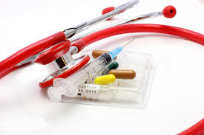
Medical Interventions

Slide 4

Doing Nothing Can be Harmful!

Slide 5
Physical Interventions for Adolescents
1. Fully reversible interventions.
GnRH agonists “puberty blockers”
Spironolactone to decrease testosterone
Oral contraceptives or Progestin to suppress menses
2. Partially reversible interventions.
Hormone therapy
3. Irreversible interventions.
Surgical procedures.

Slide 6
Typical Puberty
Female puberty ‑ onset (breast bud) age 8 to age 13
menarche < 5 years from breast bud
Male puberty ‑ onset (testicular enlargement) > age 9, to onset by age 14
Pace of puberty
Typically 2 years from breast bud to first period
Typically 2 years from testicular enlargement to growth spurt, voice changes, facial hair

Slide 7
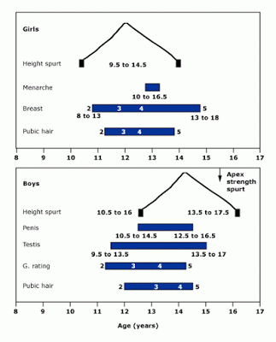
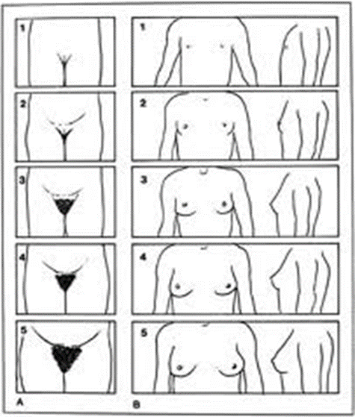
Female Pubertal Development

Slide 8

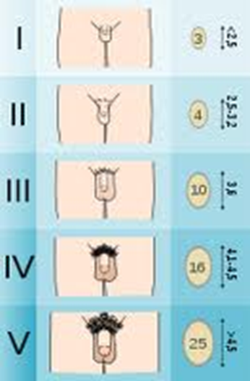
Male Pubertal Development

Slide 9
“Side Effects” of Puberty
Masculinizing changes of puberty
Deepening of voice
Adam’s apple
Facial and body hair
Skeletal changes of face
Feminizing changes of puberty
Breast growth
Change in body shape- hips/thighs
Menstrual cycles (reversible)

Slide 10
The Dutch Protocol
GnRH agonists at age 12, cross sex hormone treatment at 16.
The first 70 Dutch candidates treated with GnRH analogs between 2000 and 2008 showed improved psychological functioning.
None opted to discontinue pubertal suppression and all eventually began cross-sex hormone treatment.
More recently, the Amsterdam group found that adolescents with GID who underwent pubertal suppression had improved behavioral, emotional, and depressive symptoms with psychometric testing.
Notes:
3= Wallien study- psychosexual outcome 2008
↵ de Vries AL, =10
Steensma TD,
Doreleijers TA,
Cohen-Kettenis PT
. Puberty suppression in adolescents with gender identity disorder: a prospective follow-up study. J Sex Med. 2011;8(8):2276–2283pmid:20646177
CrossRefMedline

Slide 11
Psychological Outcome after Puberty Suppression and Gender Reassignment
55 young transgender adults were assessed at baseline prior to puberty blockers, at introduction of cross sex hormone therapy, and at least 1 year after gender reassignment surgery
After gender reassignment gender dysphoria steadily improved.
Well-being was similar to or better than same-age young adults from general population.
Improvements in psychological functioning were positively correlated with post-surgical subjective well-being
“A clinical protocol of a multi-disciplinary team with mental health professionals, physicians, and surgeons, including puberty suppression followed by cross-sex hormones and gender reassignment surgery, provides gender dysphoric youth who seek gender reassignment from early puberty on, the opportunity to develop into well-functioning young adults.
DeVries, A. et.al. “Young Adult Psychological Outcome After Puberty Suppression and Gender Reassignment” Pediatrics (2014) 134(4).

Slide 12
GnRH agonists
Leuprolide(IM injection) or Histrelin (implant) used successfully for central precocious puberty
Not FDA approved for puberty suppression in transgender children.
Has been used for decades for central precocious puberty, and is used for treatment of endometriosis, prostate cancer, and infertility in adults
Block central puberty but do not stop adrenarche- body odor, acne, or pubic hair

Slide 13
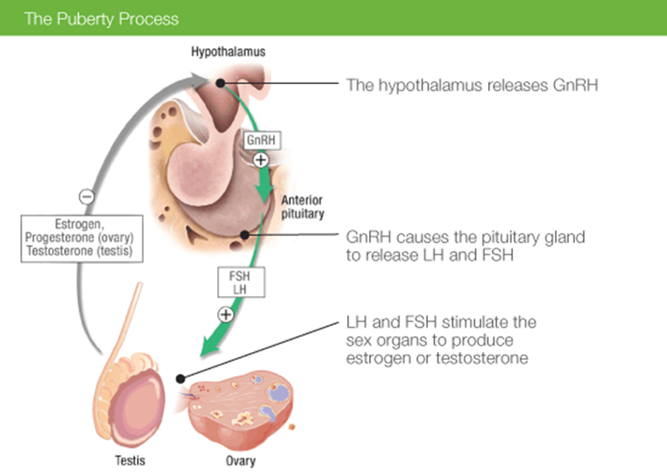
GnRH Agonists
GnRH becomes pulsatile to activate pituitary; if continuous, pituitary does NOT release LH/FSH

Slide 14
Puberty Blocker Regimens
GnRH agonists
Leurpolide Acetate IM 7.5 mg, 11.25 mg, or 15 mg monthly, 11.25, 22.5 mg or 30 mg q3 months, based on weight and efficacy
Histrelin implant 50 mg subcutaneous (yearly, but possibly longer)
Nafarelin acetate intranasal
Alternative methods
Medroxyprogesterone po (up to 40 mg/day) or 150 mg IM q 3 months
Spironolactone 100-300 mg/day to decrease androgen action
Finasteride 2.5-5 mg/day for blocking testosterone conversion to 5 –alpha DHT
Rosenthal, Stephen, “Approach to the Patient: Transgender Youth: Endocrine Considerations”, JCEM 2014

Slide 15

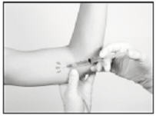
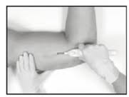
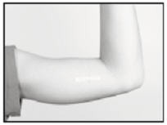
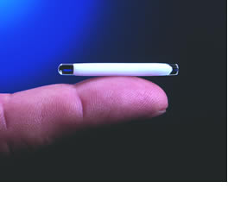
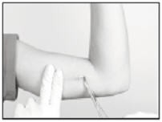
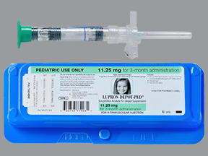
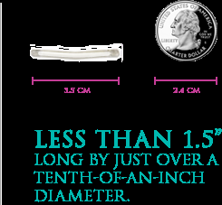

Slide 16
Benefits of Puberty Blockers
Delays or avoids development of undesired secondary sexual characteristics (breasts and periods, deeper voice, facial hair, growth spurt, genital changes)
Allows the opportunity to explore gender without the anxiety of natal pubertal development
Can avoid the need for future surgeries
Associated with decreased depression and anxiety, though not body dysphoria
Does not stop growth or cognitive development
Can act as a diagnostic procedure- if gender dysphoria worsens at puberty and is relieved by puberty blockers, possible predictive value

Slide 17
Risks of Puberty Blockers
Lack of accumulated bone density during treatment
Slower growth
Surge in hormones for one month after first shot/implant
Sterile abscess
Leg pains
Headaches
Weight gain
Risks of anesthesia if surgically implanted, and difficulty in removal (particularly if used for more than one year)
Hot flashes for pubertally mature individuals
May lag behind peers with pubertal development

Slide 18
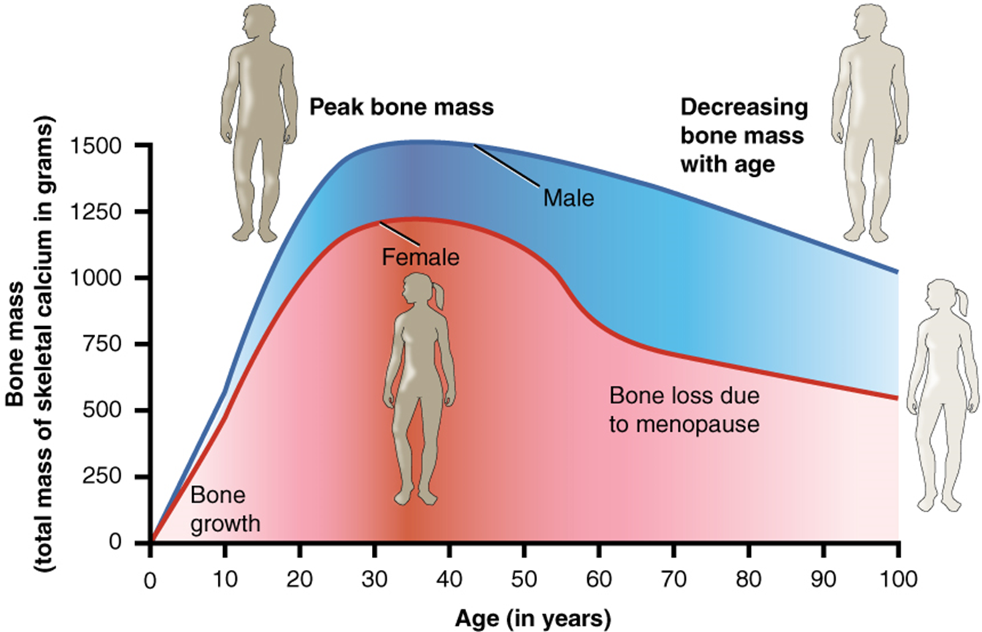
Effects on Bone Mass

Slide 19

Cost of Puberty Blockers
Monthly Pediatric Leuprolide- $1000-$2100
3 Month Pediatric Leuprolide (30 mg)- $6000
3 Month Leuprolide (22.5 mg) - $3000
Pediatric Histrelin implant- $20,000-30,000
Histrelin implant- $6,000-12,000
Insurance Coverage-
Legal issues of insurance coverage/exclusions may
depend on state.

Slide 20
Puberty Blockers for Older Adolescents
The role of puberty blockers for pubertally mature adolescents is less established
Puberty blockers can stop menses without the use of female hormones (continuous oral contraceptives or progesterone)
Puberty blockers can prevent further development in both sexes (further voice and facial hair, facial bone structures changes, body shape changes), but does NOT reverse changes that have already occurred.
If pubertally mature, then hot flashes and low libido may result

Slide 21
Timing of Puberty Blockers
WPATH, Endocrine Society, - puberty suppression at Tanner stage 2-3, cross sex hormone treatment at age 16, or earlier with parental consent, surgery after age 18 and more than 1 year of living in affirmed gender
Dutch Protocol- puberty suppression at age 12, cross sex hormone therapy at 16
Some programs in the US start cross sex hormones at age 12
Notes:
Waiting until age 12- many natal female will have started menstruating

Slide 22
Monitoring During Puberty Blocking
Growth and weight gain
LH, FSH, testosterone/estradiol
Bone age
Bone density
Calcium, phos, alk phos, Vitamin D 25 OH
+/- LFT, Creatinine, Glucose, insulin, HbA1c, Lipids

Slide 23
Cross-sex hormone therapy
What age to start
Peer concordance vs. time to mature
Benefits in appearance, psychological
Concerns about consent, irreversibility, fertility

Slide 24
Feminizing Hormone Therapy
Goals of therapy: to reduce male physical characteristics and feminize one’s body
Increase breast size
Change fat distribution to hips/buttocks/thighs
Decrease muscle mass and upper body strength
Decrease facial and body hair growth
Softer skin
Slow/stop scalp hair loss

Slide 25
Feminizing Therapy
The hormonal treatment often affects sexual function
Decrease libido
Decrease erections and ejaculate volume
Smaller, softer testes (25-50% reduction)
Sperm number and fertility may be reduced, but not necessarily

Slide 26
Feminizing Therapy
Feminizing therapy does NOT
Affect voice pitch or speech patterns
Decrease the size of the Adam’s apple
Stop facial hair growth
Stop body hair growth

Slide 27
Timing of Feminizing Effects
Effect | Onset | Maximum
Redistribution of body fat | 3-6 months | 2-3 years
Decrease in muscle mass and strength | 3-6 months | 1-2 years
Softening of skin/decreased oiliness | 3-6 months | Unknown
Decreased libido | 1-3 months | 3-6 months
Decreased Spontaneous erections | 1-3 months | 3-6 months
Male Sexual dysfunction | Variable | Variable
Breast growth | 3-6 months | 2-3 years
Decreased testicular volume | 3-6 months | 2-3 years
Decreased sperm production | Unknown | >3 years
Decreased terminal hair growth | 6-12 months | >3 years
Scalp Hair | No regrowth | n/a

Slide 28
Known Risks of Feminizing Therapy
Risk of Estrogen | Degree of Risk | Comments
Thromboembolic events- blood clots | Ethinyl estradiol had a 6-8% incidence, other types had no elevated risk. 5% incidence in those with risk factors (smoking, immobilization, hypercoagulable state) | Newer estradiol, such as skin patches had no increased risk even in women genetically prone to blood clots. MI rate for transwomen equal to cismen.
Cholesterol | Triglycerides increased by 30 points over 5 years | Other studies showed decrease in LDL, or no change
Prolactinoma (pituitary tumor) | 6 case reports | Prolactin levels may be elevated on estrogen without a tumor
Liver, creatinine, H/H, uric acid | Increase in uric acid | No other changes
Mortaility- rate of death | Increased mortality in transwomen | NOT due to hormone therapy
Cancer | 10 cases of breast cancer, lower than rates for ciswomen | No increase in mortality due to cancer
Bone health | Osteopenia in transwomen, esp if on androgen blockers prior to estrogen | No increased fracture risk
Sexual dysfunction | 1/3-2/3 of transwomen had decrease in libido | One study similar level in pre-menopausal ciswomen

Slide 29
Known Risks of Feminizing Therapy
Risks of Spironolactone | Degree of Risk | Comments
Dehydration |  | Recommend increased fluids
Hyperkalemia | Low in those with healthy kidneys and normal kidney function | May need to be on a low-potassium diet for some
Prostate Screening Antigen | PSA level may be lower | Cannot rely on test to evaluate for prostate cancer

Slide 30
Estrogen Regimens
Transdermal estradiol patch- 0.1 mg to 0.4 mg twice weekly
May start at 0.025 or 0.05 mg twice weekly with younger people
Oral estradiol 0.5 mg – 6 mg daily, may be taken sublingually
Injections
Estradiol Valerate 5-20 mg q 2 weeks (some sources say up to 40 mg q2 weeks)
Estradiol Cypionate 2-10 mg q week
Doses are for pre-orchiectomy, may be lowered postoperatively

Slide 31
Anti-Androgen Regimens
Goal of Anti-androgen is to decrease testosterone production and block androgens from binding to androgen receptor
Spironolactone
Start at 50 mg and titrate upwards
200 mg average
300 mg maximum
Notes:
Would not need to use for post-operative patient

Slide 32
Masculinizing Hormone Therapy
Goals of Therapy to reduce female physical characteristics and masculinize one’s body
Effects of Testosterone
Increased body hair
Lowers the voice pitch
Induce facial hair growth
Clitoral growth/vaginal dryness
Increased upper body strength and musculature, redistribution of fat
May induce hair loss on scalp, increase acne
Increase Libido
Decrease/stop menses

Slide 33
Masculinizing Therapy
Masculinizing therapy does NOT
Decrease breast size, though some atrophy does occur
Alter voice patterns
Typically produce enough clitoral growth sufficient for penetrative sex

Slide 34
Timing of Masculinizing Effects
Effects | Onset | Maximum
Acne/skin oiliness | 1-6 months | 1-2 years
Facial/body hair growth | 6-12 months | 4-5 years
Scalp Hair loss | 6-12 months
Increased muscle mass/strength | 6-12 months | 2-5 years
Fat redistribution | 1-6 months | 2-5 years
Cessation of menses | 2-6 months
Clitoral enlargement | 3-6 months | 1-2 years
Vaginal atrophy | 3-6 months | 1-2 years
Deepening of voice | 6-12 months | 1-2 years

Slide 35
Known Risks of Testosterone Therapy
Side Effect | Degree of Risk | Comments
Polycythemia- too many red blood cells | Higher risk if testosterone above target range | Monitor CBC, phlebotomy as treatment
Lipid changes | Increased TG by 31 mg/dL, LDL increased, HDL lower | No evidence of increased CV mortality
Increased intraabdominal fat | Increased risk of DM | Increased fasting glucose, some insulin resistance at baseline (possible PCOS)
Vaginal atrophy | Varies | Increases risk of contracting STI
Bone health | Lower BMD after oopherectomy | Risk of fracture not studied, pre-surgical testosterone maintained bone mass
Breast, ovarian, uterine cancer | 4 cases of breast cancer, ovarian cortex and stroma thickened, but only few case reports of cancer, uterine atrophy, less likely hyperplasia | Risk comparable to natal males, less risk than natal females
Emotional changes | Increased aggression, increased libido | Decreased depression and anxiety

Slide 36
Testosterone Regimens
Topical patch- 5-10 mg q24 hours
Topical gel- 5-10 g daily
WARNING- gel can transfer to close contacts easily
Injectable- Testosterone cypionate or Testosterone enanthate
Initial dose 25-40 mg weekly, or 50-80 mg every 2 weeks
Titrate up to clinical effect and testosterone levels within normal range for natal males
Typical dose 50-100 mg Q week or 100-200 mg Q 2 weeks
Subcutaneous testosterone- Jo Olson published on use of subcutaneous testosterone- can be used safely, doses needed are half of intramuscular and has less variability in levels than intramuscular
Can use 25-50mg subcutaneously weekly
Testosterone pellets
Increase dose to mimic pubertal stages

Slide 37
Risks of Non-Prescribed Medications and Treatments
Hormones obtained from the internet or friends may be of dubious quality and unknown doses
Injectable hormones have risks of shared vials or shared needles
There are higher risks of certain types of estrogen
Silicone injections can cause infections, be disfiguring, or trigger a life-threatening reaction in the body

Slide 38
Medical options for non-binary individuals
GnRH agognists can lower hormones- but not indefinitely
Low dose testosterone
Estradiol used without male hormone blocker
Intrauterine Device or implanted progesterone to stop periods
Surgery without hormones

Slide 39
Fertility
There are options to preserve fertility
Must be physically late in puberty
Sperm production occurs, on average, at age 13-14, with Tanner III-IV testes and II-III pubic hair
Egg maturation occurs, on average at age 12-13, with Tanner IV breasts and pubic hair
In order to harvest eggs, must take medications, invasive, expensive, and unclear feasibility
Sperm preservation relatively less expensive and simpler
If puberty blockers are used, then one cannot just collect sperm or eggs because they will be immature

Slide 40
Fertility
Blockers, no significant pubertal development
Blockers after pubertal development, or no blockers, and have been on sex hormone therapy
Testicular or ovarian biopsy to see if there has been sperm/egg development
No current options for fertility preservation
However, there have been advances of cryopreservation of prepubertal ovary with later successful fertility (used as part of cancer protocols)
If development has already occurred, there may be options for fertility preservation, even after hormone therapy
Transmen have had pregnancies (intentional or not) after being on testosterone for years
Transwomen have had sperm production after being on estrogen for years
There is no guarantee of fertility or infertility after hormone therapy

Slide 41
Surgical Options for Trans Youth
There are people who choose not to have surgery or cannot have surgery
Top surgery (double incision or periareolar/keyhole) is performed by some surgeons for affirmed males under 18 years
Genital reconstruction is typically reserved for those 18 years and above
Additional surgeries for transmen are removal of uterus and ovaries, removal of cervix and vagina
Additional surgeries for transwomen are removal of testes and scrotum, removal of penis
Other surgeries, such as facial feminization, tracheal shave, or breast augmentation, are sometimes performed
With early use of puberty blockers, many of these surgeries can be avoided
However, there will be less penile skin for vaginal construction
Surgeries have not been covered in the past, however, an increasing number of insurance plans are covering surgeries if medically necessary

Slide 42
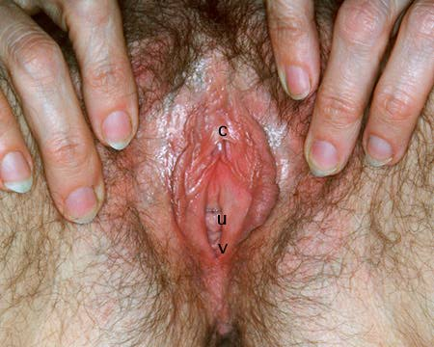
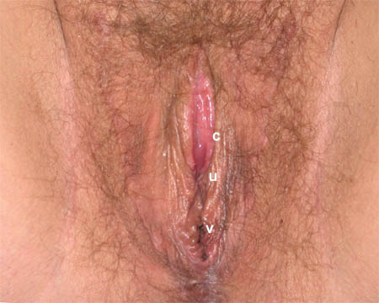
Vaginoplasty compared to genetic female
Slides courtesy of Eva Hersch, MD

Slide 43
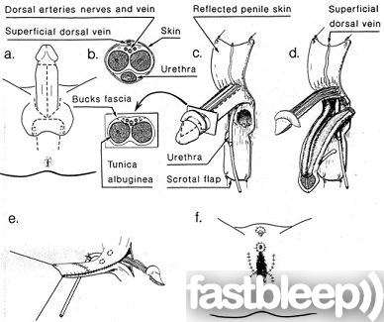
Vaginoplasty: Penile skin inversion technique

Slide 44
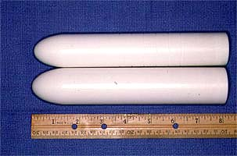
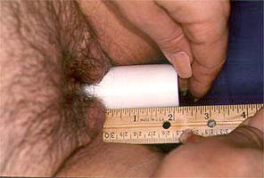
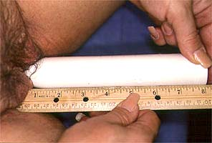
Neovaginal Dilation
Slides courtesy of Eva Hersch, MD

Slide 45
Vaginoplasty: colon graft technique
Similar to scrotal skin grafts, but vagina is constructed from rectosigmoid colon tissue.
Advantage: vagina is deep and self-lubricated.
Disadvantages:
invasive bowel surgery
excessive chronic vaginal drainage

Slide 46
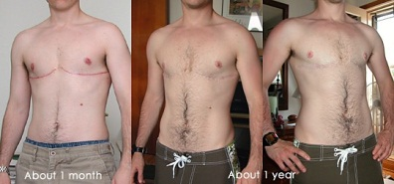
Masculinizing Chest Surgery
Slides courtesy of Eva Hersch, MD

Slide 47
Metaoidioplasty
Goals:
Ability to urinate while standing
Preservation of sensation to clitoris
Removal of vaginal cavity
Creation of a scrotal sac
Approx duration of surgery: 3-4 hours
Procedure: Clitoris release to form mini-phallus, create neourethra from mucosa of labia minora and vagina, create neoscrotum with labia majora, insert testicular implants
Slides courtesy of Eva Hersch, MD

Slide 48
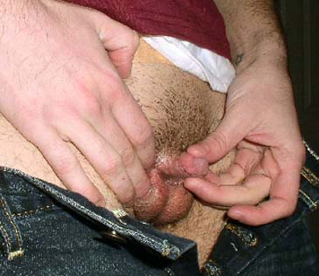
Metaoidoplasty result
Slides courtesy of Eva Hersch, MD

Slide 49
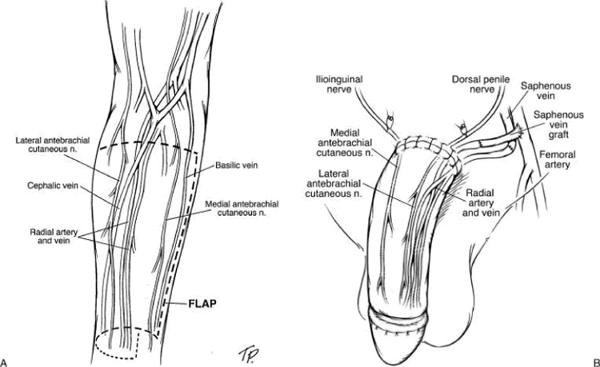
Phalloplasty

Slide 50
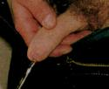
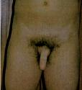
Phalloplasty, demonstrating urethroplasty
Slides courtesy of Eva Hersch, MD

Slide 51
Guidelines
World Professional Association for Transgender Health (WPATH) Standard of Care, Seventh Version, 2012
Primary Care Protocol for Transgender Patient Care, 2011- UCSF Center for Transgender Excellence
The Endocrine Society Clinical Practice Guidelines- Endocrine Treatment of Transsexual Persons, 2009
Protocols for Hormonal Gender Reassignment- Tom Waddell Center, 2006
Guidelines for Transgender Care, Trans Care Project, 2006, Vancouver, British Columbia
Notes:
Flexible guidelines, each has pros and cons, WPATH is very comprehensive and recognizes that it is a guide, Endo Society – doses assume everyone is on puberty blockers until age 16 and blocked when starting cross sex hormones, Tom Waddell Center- serves primary indigent and homeless population.

