Slide 1

Psychiatric Medicine for Gender-Nonconforming Children and Adolescents
Ariel Vitali, MD Staff Psychiatrist Chase Brexton Health Care
April 30, 2016

Slide 2
Financial Disclosures
None

Slide 3
Outline
What is happening out there?
Categorization of gender-nonconformity
Co-morbidities
Risks and outcomes of treatment

Slide 4

Gender-nonconformity and being transgender is not new
Gender-variant phenomena have existed for millennia.
This is not necessarily a “trend.”
Societal acceptance – to a degree.
More people are coming out as some form of gender-variant, and coming out at younger ages.
Significant changes – positive and negative – even over the past six years.

Slide 5

No, it’s not you.
Terms ARE a moving target.
Descriptors and labels change often.
It can be confusing.

Slide 6
DSM-IV vs. DSM-5
Attempts at de-stigmatization

Slide 7
Diagnostic Criteria for Gender Identity Disorder (DSM-IV-TR)
A strong and persistent cross-gender identification (not merely a desire for any perceived cultural advantages of being the other sex). In children, the disturbance is manifested by four (or more) of the following:
repeatedly stated desire to be, or insistence that he or she is, the other sex
in boys, preference for cross-dressing or simulating female attire; in girls, insistence on wearing only stereotypical masculine clothing
strong and persistent preferences for cross-sex roles in make-believe play or persistent fantasies of being the other sex
intense desire to participate in the stereotypical games and pastimes of the other sex
strong preference for playmates of the other sex In adolescents and adults, the disturbance is manifested by symptoms such as a stated desire to be the other sex, desire to live or be treated as the other sex, or the conviction that he or she has the typical feelings and reactions of the other sex.
Source: APA, 1994, Diagnostic and Statistical Manual of Mental Disorders, Fourth Edition. Copyright 1994 American Psychiatric Association.

Slide 8
Diagnostic Criteria for Gender Identity Disorder (DSM-IV-TR) (cont’d.)
Persistent discomfort with his or her sex or sense of inappropriateness in the gender role of that sex. In children, the disturbance is manifested in any one of the following: in boys, assertion that his penis or testes are disgusting or will disappear or assertion that it would be better to not have a penis, or aversion toward rough -and-tumble play and rejection of male stereotypical toys, games, and activities; in girls, rejection of urinating in a sitting position , assertion that she has or will grow a penis , or assertion that she does not want to grow breasts or menstruate, or marked aversion toward normative feminine clothing. In adolescents and adults, the disturbance is manifested by symptoms such as preoccupation with getting rid of primary and secondary sex characteristics (e.g., request for hormones, surgery, or other procedures to physically alter sexual characteristics to simulate the other sex) or belief that he or she was born the wrong sex.
The disturbance is not concurrent with a physical intersex condition.
The disturbance causes clinically significant distress or impairment in social, occupational, or other important areas of functioning. Source: APA, 1994, Diagnostic and Statistical Manual of Mental Disorders, Fourth Edition. Copyright 1994 American Psychiatric Association

Slide 9
Diagnostic Criteria for Gender Dysphoria in Children (DSM-5)
A marked incongruence between one’s experienced/expressed gender and assigned gender, of at least 6 months’ duration, as manifested by at least six of the following (one of which must be Criterion A1):
A strong desire to be of the other gender or an insistence that one is the other gen­der (or some alternative gender different from one’s assigned gender).
In boys (assigned gender), a strong preference for cross-dressing or simulating fe­male attire: or in girls (assigned gender), a strong preference for wearing only typ­ical masculine clothing and a strong resistance to the wearing of typical feminine clothing.
A strong preference for cross-gender roles in make-believe play or fantasy play.
A strong preference for the toys, games, or activities stereotypically used or engaged in by the other gender.
A strong preference for playmates of the other gender.
In boys (assigned gender), a strong rejection of typically masculine toys, games, and activities and a strong avoidance of rough-and-tumble play; or in girls (assigned gender), a strong rejection of typically feminine toys, games, and activities.
A strong dislike of one’s sexual anatomy.
A strong desire for the primary and/or secondary sex characteristics that match one’s experienced gender. Source: APA, 2013, Diagnostic and Statistical Manual of Mental Disorders, Fifth Edition. Copyright 2013 American Psychiatric Association.

Slide 10
Diagnostic Criteria for Gender Dysphoria in Children (DSM-5)
The condition is associated with clinically significant distress or impairment in social, school, or other important areas of functioning.
Specify if: With a disorder of sex development (e.g., a congenital adrenogenital disorder such as 255.2 [E25.0] congenital adrenal hyperplasia or 259.50 [E34.50] androgen insensi­tivity syndrome).
Coding note: Code the disorder of sex development as well as gender dysphoria. Source: APA, 2013, Diagnostic and Statistical Manual of Mental Disorders, Fifth Edition. Copyright 2013 American Psychiatric Association.

Slide 11
Diagnostic Criteria for Gender Dysphoria in Adolescents and Adults (DSM-5)
A marked incongruence between one’s experienced/expressed gender and assigned gender, of at least 6 months’ duration, as manifested by at least two of the following:
A marked incongruence between one’s experienced/expressed gender and primary and/or secondary sex characteristics (or in young adolescents, the anticipated secondary sex characteristics).
A strong desire to be rid of one’s primary and/or secondary sex characteristics be­cause of a marked incongruence with one’s experienced/expressed gender (or in young adolescents, a desire to prevent the development of the anticipated secondary sex characteristics).
A strong desire for the primary and/or secondary sex characteristics of the other gender.
A strong desire to be of the other gender (or some alternative gender different from one’s assigned gender).
A strong desire to be treated as the other gender (or some alternative gender dif­ferent from one’s assigned gender).
A strong conviction that one has the typical feelings and reactions of the other gen­der (or some alternative gender different from one’s assigned gender). Source: APA, 2013, Diagnostic and Statistical Manual of Mental Disorders, Fifth Edition. Copyright 2013 American Psychiatric Association.

Slide 12
Diagnostic Criteria for Gender Dysphoria in Adolescents and Adults (DSM-5)
The condition is associated with clinically significant distress or impairment in social, occupational or other important areas of functioning.
Specify if: With a disorder of sex development (e.g., a congenital adrenogenital disorder such as 255.2 [E25.0] congenital adrenal hyperplasia or 259.50 [E34.50] androgen insensi­tivity syndrome).
Coding note: Code the disorder of sex development as well as gender dysphoria.
Specify if: Post-transition: The individual has transitioned to full-time living in the desired gender (with or without legalization of gender change) and has undergone (or is preparing to have) at least one cross-sex medical procedure or treatment regimen—namely, regu­lar cross-sex hormone treatment or gender reassignment surgery confirming the desired gender (e.g., penectomy, vaginoplasty in a natal male; mastectomy or phalloplasty in a natal female). Source: APA, 2013, Diagnostic and Statistical Manual of Mental Disorders, Fifth Edition. Copyright 2013 American Psychiatric Association.

Slide 13

Psychiatric Co-morbidity
Major Depressive Disorder (current and lifetime)
Suicidality
Generalized Anxiety Disorder
Post-Traumatic Stress Disorder
School Phobia
Autistic Disorders
Eating Disorders
Alcohol Dependence
Other Substance Use Disorders

Slide 14
Trauma
“I think that gender dysphoria represents a classic form of trauma, in that it is deeply distressing and makes the person feel helpless, sad, and scared. Because it involves a central organizing factor of one's existence, i.e., gender, it is inescapable…When looking at posttraumatic stress disorder, I think that, with the possible exception of flashbacks, there are many similarities in the symptoms reported by trans folks (sic).”
- Maureen Osborne, Ph.D. (personal conversation)

Slide 15

Non-psychiatric co-morbidity
Poor follow-up with primary care
HIV/AIDS
Isolation
Unemployment
Poor educational outcomes
Homelessness

Slide 16
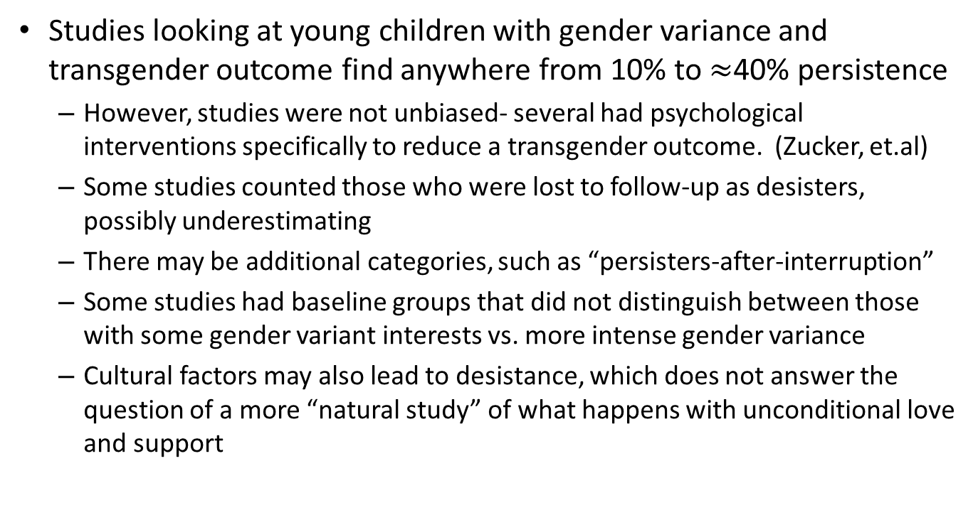
Studies of Persistence
Studies looking at young children with gender variance and transgender outcome find anywhere from 10% to $≈$40% persistence
However, studies were not unbiased- several had psychological interventions specifically to reduce a transgender outcome. (Zucker, et.al)
Some studies counted those who were lost to follow-up as desisters, possibly underestimating
There may be additional categories, such as “persisters-after-interruption”
Some studies had baseline groups that did not distinguish between those with some gender variant interests vs. more intense gender variance
Cultural factors may also lead to desistance, which does not answer the question of a more “natural study” of what happens with unconditional love and support

Slide 17
Persistence of Gender Variance
Studies of Children-
Davenport, 1986- found 1 out of 10 feminine boys persisted as transgender
Green et.al. 1987 found 20% of childhood Gender Identity Disorder persisted into adulthood, but 70% identified as homosexual or bisexual
Toronto Group
Zucker et.al. 2005 found 20% of 40 MTF identified children diagnosed with gender identity disorder as adults
Drummond, et.al. 2008 found of 25 FTM children referred, 16 met criteria for GID as children and 3 as adults (12%)

Slide 18
Persistence vs. Desistance in 53 children/adolescents- Qualitative factors
Persisters (29= 54.7%)
Desisters (23 = 41.4%)
“I am a boy”
Intense dislike of genitalia, wanting to be rid of a penis, or wanting a penis
Anticipated and actual pubertal changes brought great distress, body aversion intensified and caused social withdrawal and insecurity
“I wish I were a boy”
Body discomfort due to wish for a body to fulfill social role, boys did not recall wishing they did not have a penis
At adolescence were more open to gender typical activities and friendships, decreased urge for cross dressing
Anticipated pubertal changes distressful, and early breast development distressful, but then desired more physical development. Boys were not distressed at first pubertal changes
Feelings of attraction and love were connected to decreased gender dysphoria
Steensma, 2011
Notes:
Qualitative study from 2013- persisters “are” the affirmed gender, desisters “wished to be”. Peristers
Before the age of 10 (grade 1 to 6 in the Netherlands), the social differences between boys and girls were experienced as relatively small, as boys and girls did play with each other, and gender roles were less salient. Around the age of 10/11 (grade 7 in the Netherlands), the social distance between boys and girls was considered to increase gradually.
Social environment generally positive and accepting of coming out (male peers bullied, female peers ignored), adults had a harder time than peers.

Slide 19
Persistence of Gender Variance- is it “Just a Phase”?
Wallien and Cohen-Ketteris (2008)
Studied 77 children referred to the clinic for gender dysphoria
20% of natal males persisted with GID
50% of natal females persisted with GID
30% of children did not respond- these were included in desisters, so study may underestimate
Criteria for “persistence” included desire for sexual reassignment surgery, which does not include transgender people who do not desire surgery
Research shows that adolescents presenting as transgender will continue on as transgender young adults and adults (DeVries et al, 2010)
Notes:
The Family Acceptance Project, conducted by Dr. Caitlin Ryan at San Francisco State University, examines how family attitudes affect the health, mental health and well-being of lesbian, gay, bisexual and transgender young people. The study (publication forthcoming) shows that LGBT young adults who experienced high levels of parental pressure regarding gender conformity report significantly higher levels of depression, illegal drug use, suicide attempts and unsafe sex than their peers who report little or no pressure.

Slide 20
Factors Associated with Persistence
Persisters (29= 54.7%) (47=37%)
“I am a boy” not “I want to be a boy”
Intense dislike of genitalia, wanting to be rid of a penis, or wanting a penis
Anticipated and actual pubertal changes brought great distress, body aversion intensified and caused social withdrawal and insecurity
Higher scores on body dysphoria questions
Social transition
Older age, natal females more likely
Notes:
Qualitative study from 2013- persisters “are” the affirmed gender, desisters “wished to be”. Peristers
Before the age of 10 (grade 1 to 6 in the Netherlands), the social differences between boys and girls were experienced as relatively small, as boys and girls did play with each other, and gender roles were less salient. Around the age of 10/11 (grade 7 in the Netherlands), the social distance between boys and girls was considered to increase gradually.
Social environment generally positive and accepting of coming out (male peers bullied, female peers ignored), adults had a harder time than peers.

Slide 21
Factors Associated with Desistence Desisters (n =23, 45%) (n=80, 63%)
“I wish I were a boy”
Body discomfort due to wish for a body to fulfill social role, boys did not recall wishing they did not have a penis
Mores “subthreshold” scores on gender dysphoria questionnaires
Anticipated pubertal changes distressful, but pubertal development not distressing
More likely younger, and natal male

Slide 22
Medical and Surgical Interventions
Insistence, consistence, persistence
In general, THEY REDUCE PSYCHIATRIC RISKS.
Olson, Durwood, et al.
Interventions result in rates of psychiatric disorders similar to non-transgender children and youth.
There is no greater risk for depressive or anxious disorders.
There is no greater risk for suicidality.
Study only showed results for adolescents.
[other outcome study]

Slide 23
Affirmative Intervention for Families with Gender Variant Children
Treatment focused on parents
Acceptance and unconditional love are central to a healthy gender-variant child/adolescent
Helping parents understand and support their child’s declared gender, and to encourage the child to have a safe cross-gender exploratory experience, helping parents cope with antipathy about gender variance
Therapists focus intervention on sensitivity training in schools, violence prevention, and developing skills to deal with unsupportive peers/family/schools
States that pressure to conform to gender stereotypes led to reduced acceptance by peers, increased withdrawal, social isolation, feelings of shame, lower self-esteem
A study of families choosing the affirmative approach showed similar levels of gender variance, but less pathological tendencies
Hill, Menvielle, Sica, and Johnson, 2010

Slide 24
Mental Health of Transgender Children Who Are Supported in Their Identities
Study by Kristina Olson (Pediatrics, 2016) looked at prepubertal transgender children ages 3-12, who socially transitioned
Mental health was compared between transgender children and their cisgender siblings or peers
The transgender children had similar rates of depression and only slightly higher rates of anxiety
Mental health struggles are not necessarily inevitable for transgender youth

Slide 25
Treatment Outcomes
WPATH guidelines on psychiatric/psychological evaluations on children and adolescents.
It is still important to manage psychiatric illnesses, when they exist.

Slide 27
Thank you.

